Slide 1
Meet the Teacher
Year 6
Team Final Countdown

Slide 2
Who works in the classroom?
Mrs Bunker and Mrs Stewart
Mrs Spain
Mrs Turner

Slide 3
What does a day in Year 6 look like?
Reading, arithmetic, Maths, spelling, English in the morning
Other subjects in the afternoon

Slide 4
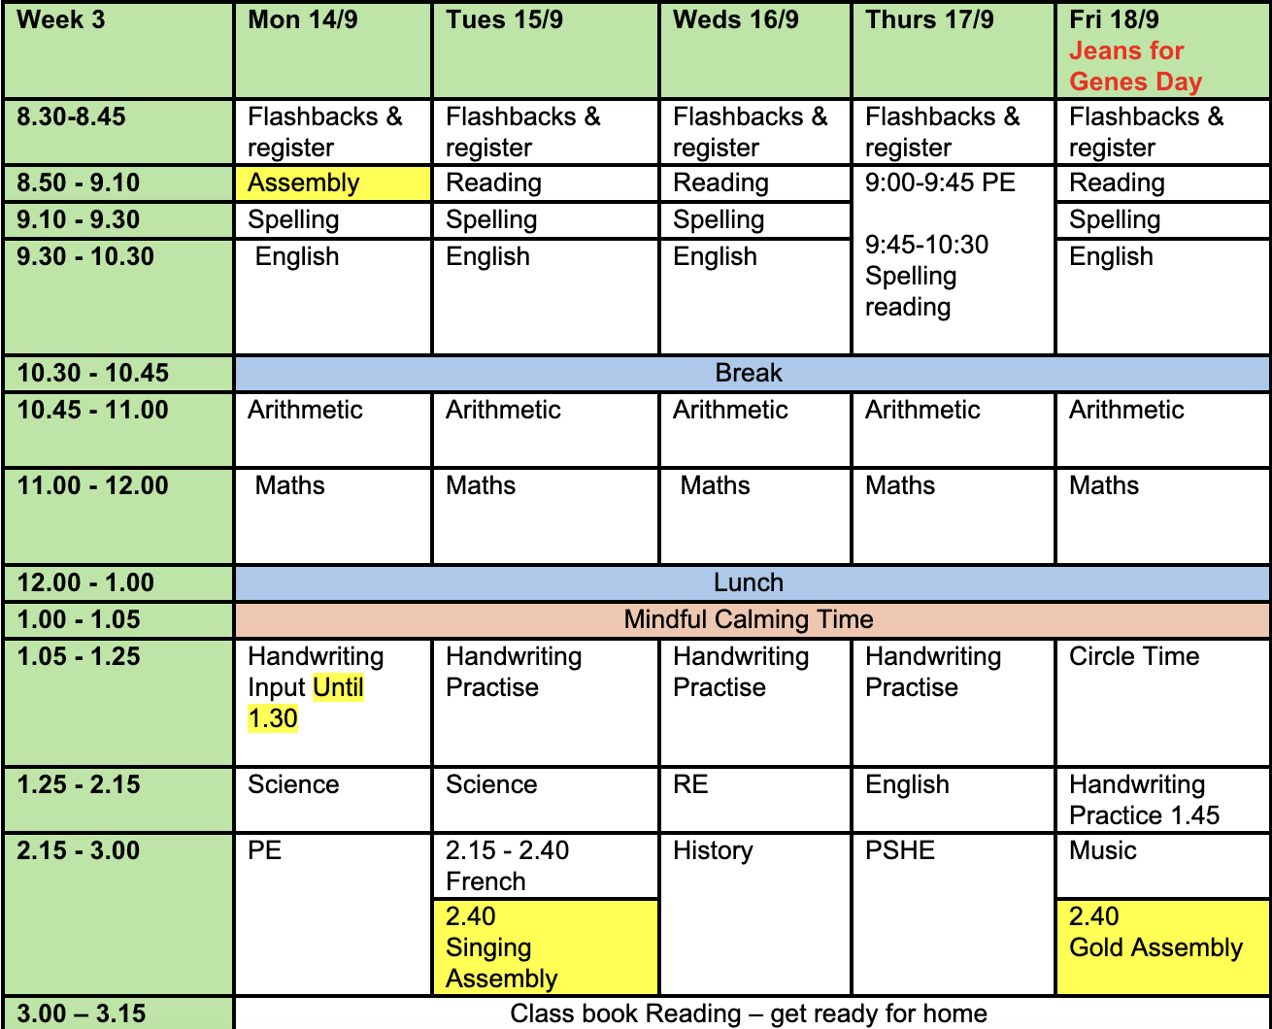
We will teach art and computing at the end of the term.

Slide 5
How do we communicate?
Contact books – day-to-day communication
Emails/ phone calls
Newsletters
Class Newsletters
Class page on website

Slide 6
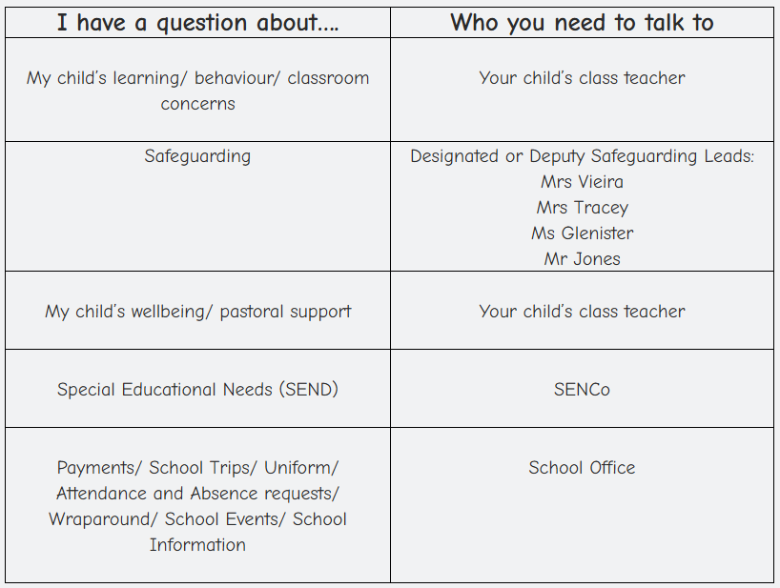
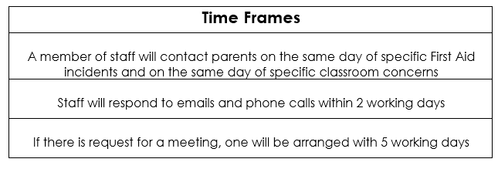
Who to speak to?

Slide 7
When is PE and Earth Class?
This term, P.E will be on a Monday and on a Thursday
We will have Earth Class in terms 2 and 6
Earth Class Reminder
Pupils should wear clothes that they don’t mind getting dirty and are appropriate for the weather. Wellies should be brought to school for every session so that pupils have footwear to change into when outside. During the winter, pupils should bring coats and warm clothing and during the summer. Except for extreme circumstances where communication will be made, pupils should wear long sleeve tops and bottoms for protection.

Slide 8
What are the homework expectations?
Reading a book of their choice with an adult, at least 3 times a week.
One maths task a week
Theme-once a term (optional)

Slide 9
What are the uniform expectations?
Our uniform consists of:
White polo shirt – either plain or with the Sutton Valence Primary school logo
Forest green school jumper or cardigan - either plain or with the Sutton Valence Primary school logo (jumpers with brand logos are not permitted)
Black or grey trousers or skirts for winter
Black or grey shorts or green chequered dress for summer
White, grey or black plain socks or tights
A peaked cap for summer protection (sunglasses are not permitted)
Footwear
Black flat sensible, safe shoes with good grip on the sole. Alternatively, smart, black trainers with no white or coloured flashes or patters. Bright coloured laces are not permitted. Shoes with open toes are not permitted in the summer.
Make-up and Jewellery
No make-up is to be worn to school (this includes nail polish)
It is encouraged that pupils do not wear jewellery to school, especially as individuals become very upset if a treasured piece of jewellery goes missing or is damaged. The only acceptable items of jewellery permitted are small studs for pierced ears and sensible watches. Please note that school will be unable to take any responsibility for any jewellery/ watches lost or damaged.
Hair​
Hair longer than shoulder length must be tied up neatly at all times using plain hair accessories.​
No decorative or brightly coloured hair accessories are permitted.​
Hair should be clean, tidy, and off the face.​
Extreme hairstyles, such as shaved patterns or unnatural colours, are not allowed.​
PE Kit​
White or house colour T-shirt​
Black or grey tracksuit bottoms or shorts​
Trainers/ black plimsolls​
School jumper/hoodie or plain black/grey jumper/hoodie​
Swimming: swimming costume/ trunks/ towel/ swimming hat for long hai​r

Slide 10
What does my child need to bring in to school every day?
Water bottle
Contact book
Reading record
Hat if hot
Packed lunch if needed

Slide 11
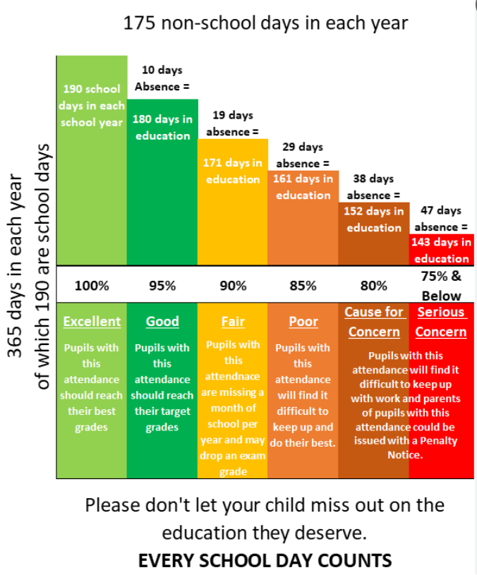
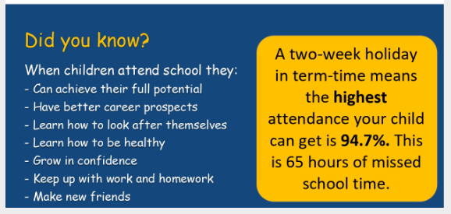
Attendance – why is it important?

Slide 12
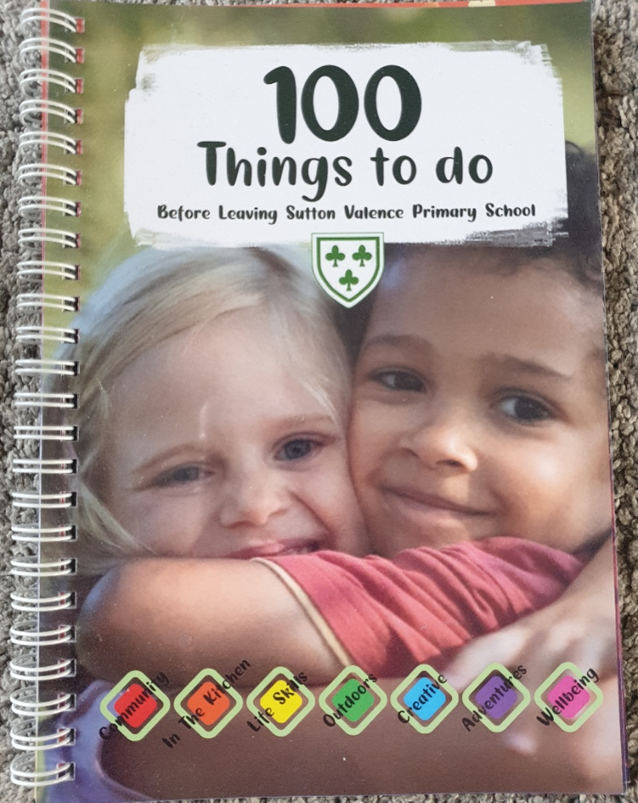
100 Things to do Before Leaving Sutton Valence
The challenge (should you choose to accept it…)
We challenge each child to experience the 100 totally awesome activities on our bucket list before you leave Sutton Valence Primary School.
These activities will support them in becoming resilient and confident, and hopefully give them a head start for your next steps after primary school. Whether they’re creative, crafty or an active explorer there are sure to be activities included that are fun for all!

Slide 13
100 Things to do Before Leaving Sutton Valence
Reminder that we strongly encourage children to take on the challenges and engage with these outside of school. Too much focus is on academics and these core childhood activities can be missed.
Stickers and tokens will be given out each week on a Friday.
If you have lost your book please speak to the office about getting a new one.

Slide 14

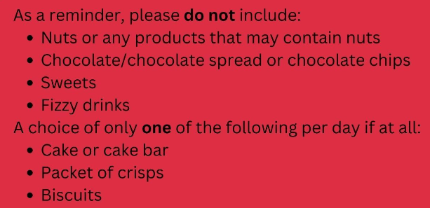
Lunches

Slide 15
After School Clubs
We have a range of after school clubs on offer – some are organised by outside companies and some are led by members of staff
To see what clubs are on offer and how to book them, please see our school website. You will find the page under the community tab.
Each term a PING will be sent out enabling you to book onto clubs.

Slide 16

PTFA – can you help?
The PTFA are an integral part of the school community. Without them, the children wouldn’t have the opportunity to take part in events such as school discos, creating gifts for Mother’s Day and Father’s Day or Easter Egg Hunts to name but a few. Parents wouldn’t be able to attend Bingo Nights and the whole school community wouldn’t be able to attend events such as the Christmas craft night orSummer Fair. These are all organised by the PTFA and always enjoyed by all those that attend.
The money that they raise through all the events goes back into supporting the school and most importantly the children. Over the last few years, we have been able to update the smartboards in all the classrooms, changing the play equipment on the school field and Year 6 leavers hoodies in addition to all the other extras they are able to offer for the children.
The PTFA can only continue to organise these events and contribute to the school if they have parent volunteers to help support at the events. So if you are able to support in any way this year, please let the PTFA know.
Pleased to share that the new Chair of the PTFA is Kerry Perkins

